Slide 1

Adversarial attacks(AA) in machine learning: What they are and how to stop them?
Author: Mark Zakharov

Slide 2
What is AA
Adversarial machine learning attack is a technique in which one tries to fool deep learning models with false or deceptive data with a goal to cause the model to make inaccurate predictions. The objective of the adversary is to cause the model to malfunction.

Slide 3
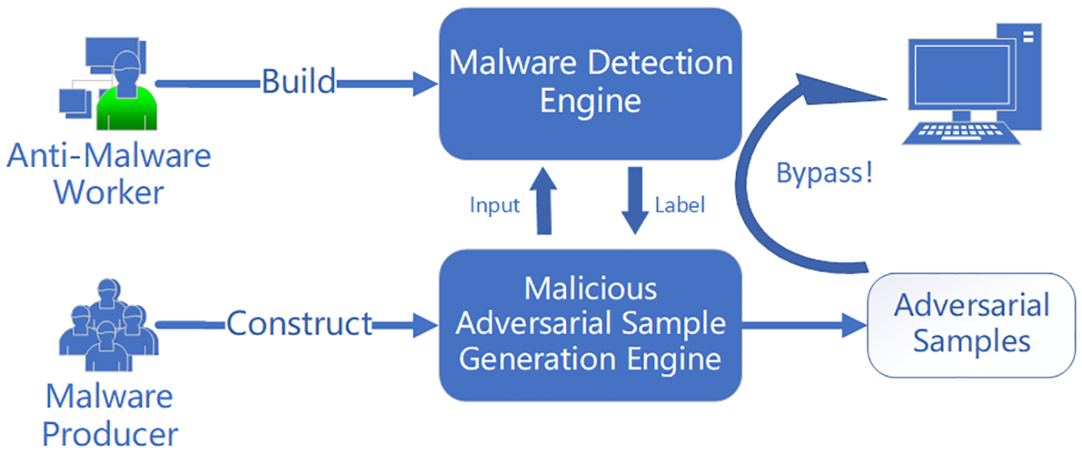
Image source: https://journals.plos.org/plosone/article?id=10.1371/journal.pone.0231626

Slide 4
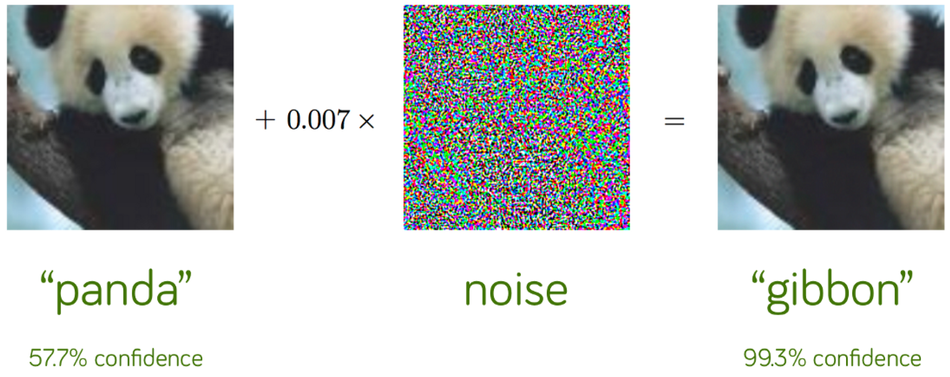
Example of AA
Image source: https://www.mdpi.com/2077-0383/12/9/3266/htm

Slide 5
Types of AA
White box: Fast Gradient Sign Method (FGSM), Projected Gradient Descent (PGD), Carlini-Wagner (CW)
Black box: Zeroth Order Optimization Based attack, Limited Queries and Information Attack

Slide 6
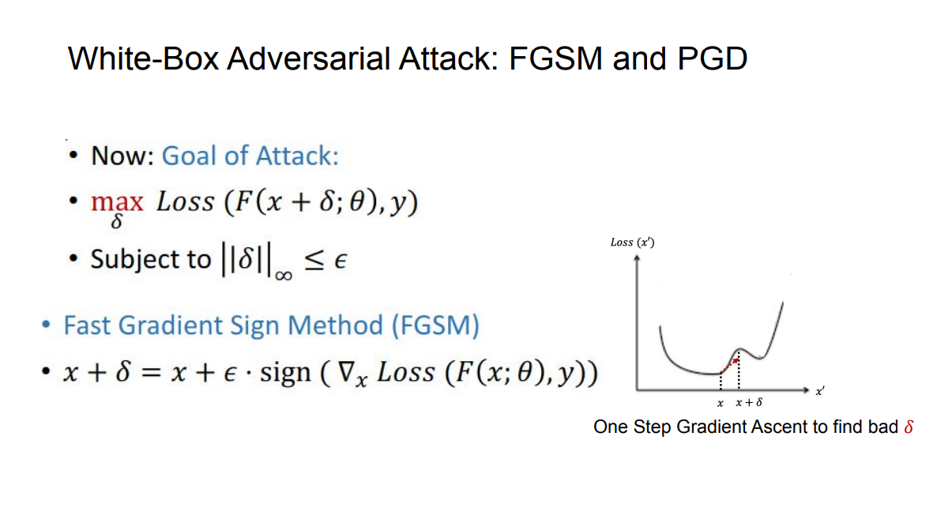

Slide 7
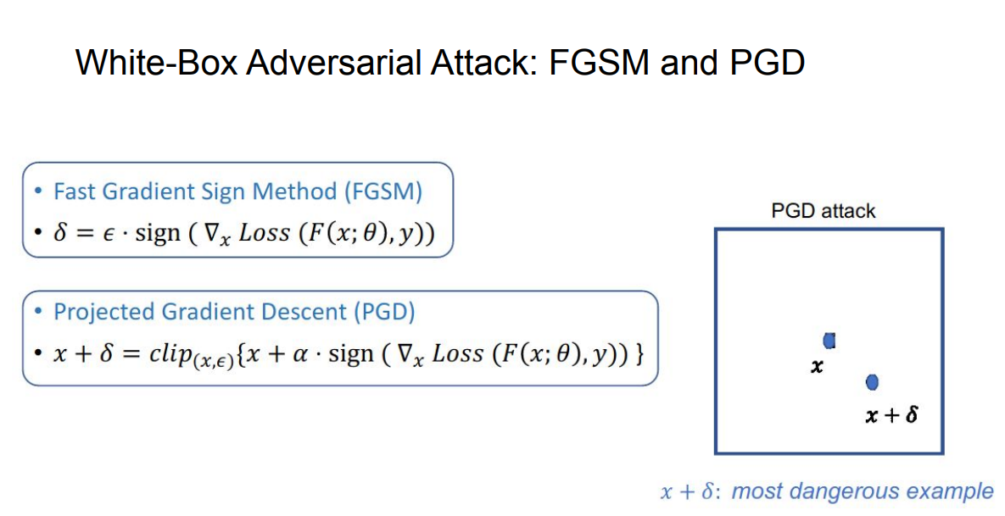

Slide 8

How to stop AA
We can utilize a technique known as “adversarial training” to enhance model robustness. This method incorporates adversarial examples into the training process, thereby improving the model’s resilience. It operates by solving following minimax problem:

Slide 9
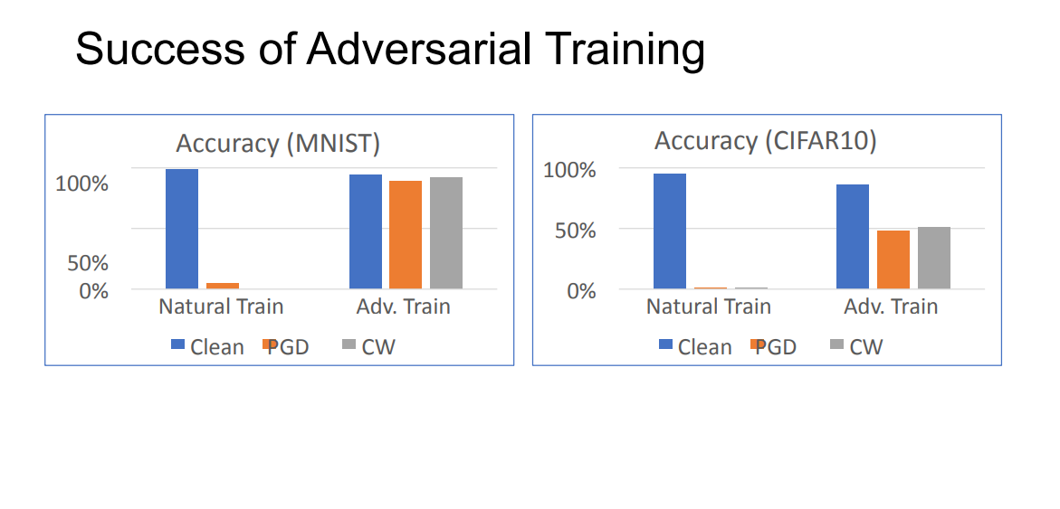

Slide 10

Thanks for watching!

Slide 11
References:
https://www.aiplusinfo.com/blog/adversarial-attacks-in-machine-learning-what-they-are-and-how-to-defend-against-them/#:~:text=Adversarial%20machine%20learning%20attack%20is,cause%20the%20model%20to%20malfunction
https://adversarial-ml-tutorial.org
https://github.com/Get-My-Money/Flipped-class-presentation/tree/main/Reference%20presentations (Used materials from [S23] Security and Interpretability of Machine Learning course, so it is closed for strangers)

